Slide 1
Microsoft Azure
Dae Woo Kim (daewoo.kim@)
Technology Evangelist
Microsoft Korea

Slide 2
https://aka.ms/cs492b

Slide 3

28
Azure regions around the world
Hyper-scale footprint
Latest launch was in October 2015- India – Central, India – South, India – West
GENERALLY AVAILABLE
6 new regions announced: Canada Central, Canada East, Germany Central,
Germany North East, United Kingdom (2 – regions TBD)
More than AWS and Google Cloud combined
Azure regions

Slide 4
Hyper-scale
Azure
Enterprise proven
Hybrid

Slide 5
>90,000
New Azure customer subscriptions/month
>1.5Million
SQL Databases running on Azure
>500Million
Users in Azure Active Directory
Azure momentum
1.5Trillion
Messages per month processed by Azure IoT
777Trillion
Storage Transactions per day
>40%
Revenue from Start-ups and ISVs

Slide 6


























>80% of Fortune 500 use the Microsoft Cloud

Slide 7
Virtual Machines
Getting started
Select image and VM size
New disk persisted in storage
Management portal
Windows Server
Boot VM from new disk
>_
Linux
Scripting
(Windows, Linux and Mac)
Blob Storage
General Purpose
Basic
Standard
Optimized Compute
Performance Optimized
Network Optimized
REST API
Cloud
Comprehensive
Networking

Slide 8
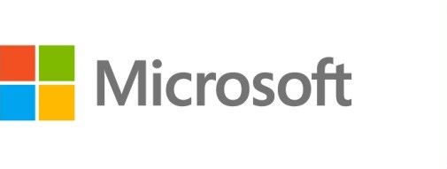






Azure Virtual Machines
Launch Windows Server and Linux in minutes
Scale from 1 to 1000s of VM Instances
Save money with per-minute billing
Open and extensible

Slide 9


Provisioning VM
Getting Started
Select Image and VM Size
New Disk Persisted in Storage
Windows Server
Management Portal
Boot VM from New Disk
Linux
>_
General Purpose
Basic
Standard
Optimized Compute
Performance Optimized
Network Optimized
Scripting
(Windows, Linux and Mac)
Cloud
REST API

Slide 10

















VM Gallery
A collection of prebuilt images for various workloads
Windows Server 2012 R2
Ubuntu Server 14.04 LTS
CentOS 6.5
SUSE Linux
Enterprise Server
openSUSE 13.1
Oracle Linux 6.4.0.0.0
SQL Server 2014 Standard
Oracle Database 11g R2
SharePoint Server Farm
Microsoft Dynamics
GP 2013
Zulu 8
BizTalk Server 2013
SAP HANA
Developer Edition
Puppet Enterprise 3.2.3
Barracuda Web Application
Oracle WebLogic
Server 12.1.2
Visual Studio Ultimate 2013
Windows 8.1 Enterprise

Slide 11
Virtual Machine Sizes
General Purpose compute: Basic
General Purpose compute: Standard
Optimized Compute
Performance Optimized
Network Optimized

Slide 12
Scale-up options
Highest value
Largest scale-up
A
D
G
N
DV2
Highest value
Most memory fastest CPUs
GPU-enabled virtual machines
SSD Storage Fast CPUs
>80,000 IOPs
Premium Storage
New generation of D family VMs
35% faster than D
Intel E5-2673 v3 CPUs
NVIDIA GPUs
Remote visualization
Compute-intensive + RDMA
Largest virtual machines Fastest storage in the public cloud

Slide 13
General Purpose Compute
Basic Tier
An economical option for development workloads, test servers, and other applications that don't require load balancing, auto-scaling, or memory-intensive virtual machines.
Instance | Cores | RAM | Disk sizes
A0 | 1 | 0.75 GB | 20 GB
A1 | 1 | 1.75 GB | 40 GB
A2 | 2 | 3.5 GB | 60 GB
A3 | 4 | 7 GB | 120 GB
A4 | 8 | 14 GB | 240 GB

Slide 14
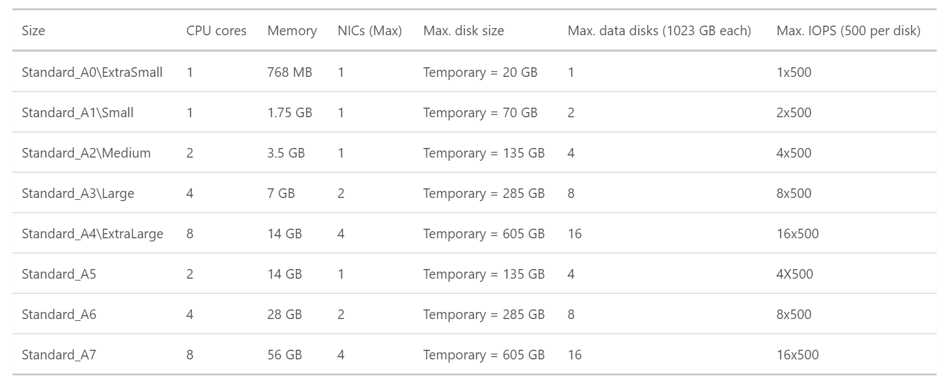
General Purpose Compute
Standard Tier
Offers the most flexibility. Supports all virtual machine configurations and features

Slide 15
General Purpose Compute
Network optimized with Infiniband support
Adds a 40Gbit/s InfiniBand network with remote direct memory access (RDMA) technology.
Instance | Cores | RAM | Disk sizes
A8 | 8 | 56 GB | 382 GB
A9 | 16 | 112 GB | 382 GB
Adds a 40Gbit/s InfiniBand network with remote direct memory access (RDMA) technology. Ideal for Message Passing Interface (MPI) applications, high-performance clusters, modeling and simulations, video encoding, and other compute or network intensive scenarios.

Slide 16
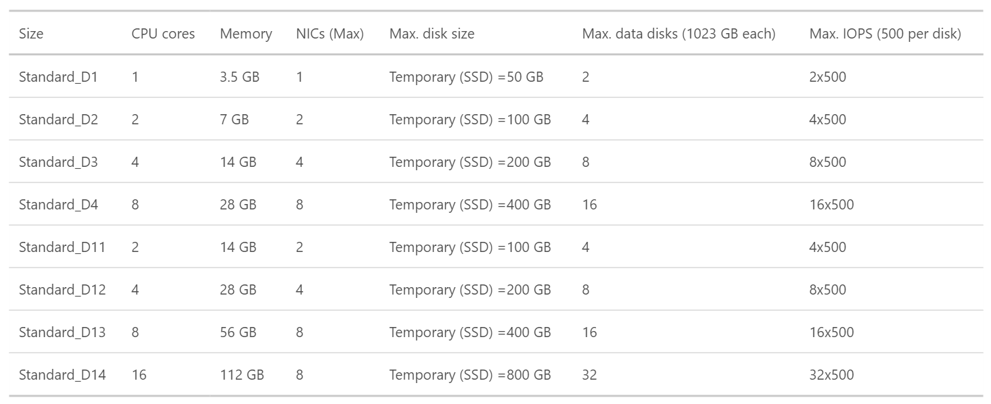
Optimized Compute (D Tier)- 60% faster CPUs, more memory, and local SSD

Slide 17
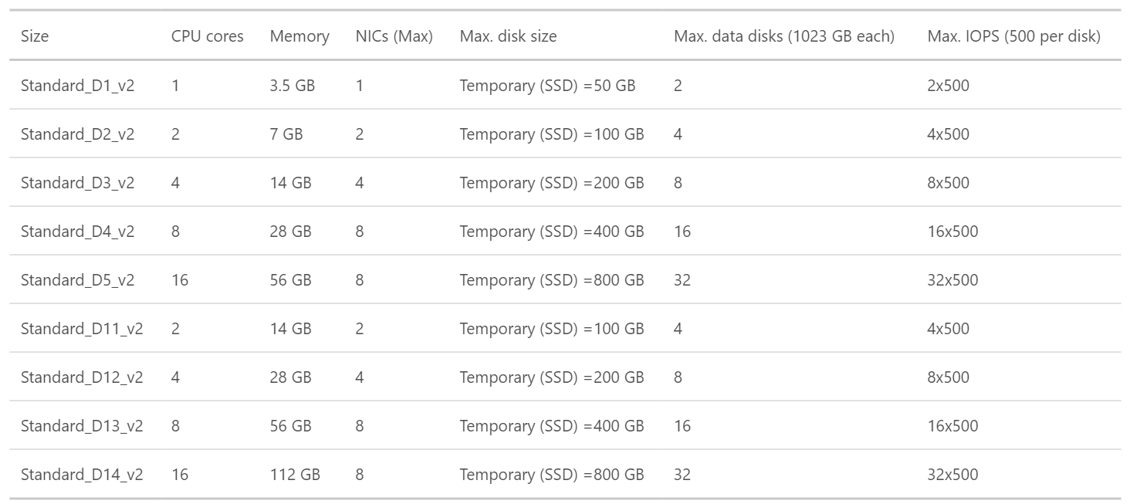
Dv2 Series- 35% faster than D series, 2.4 GHz Intel Xeon® E5-2673 v3 (Haswell) processor

Slide 18
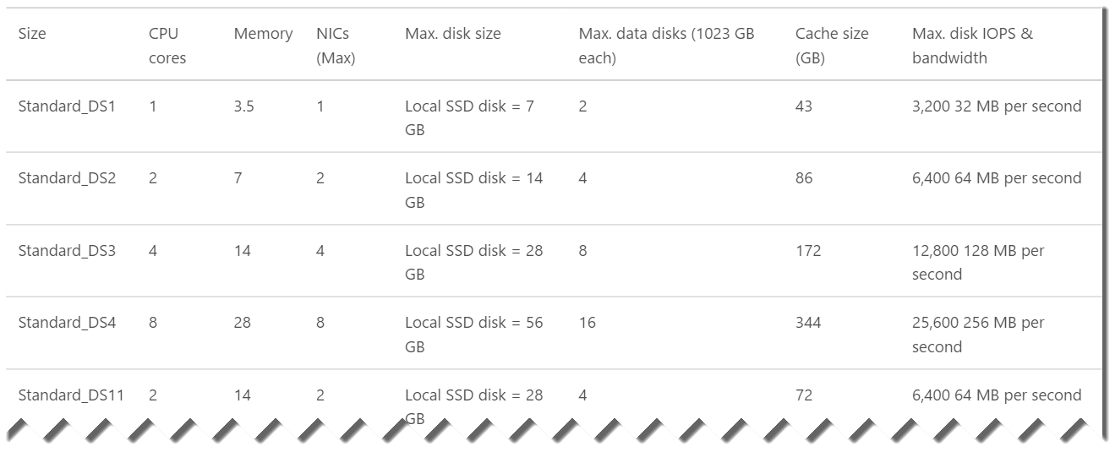
DS-series VMs can use Premium Storage- high-performance, low-latency storage.

Slide 19
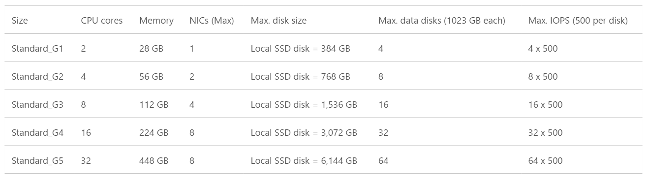
G-series VMs offer the most memory and run on hosts that have Intel Xeon E5 V3 family processors.

Slide 20
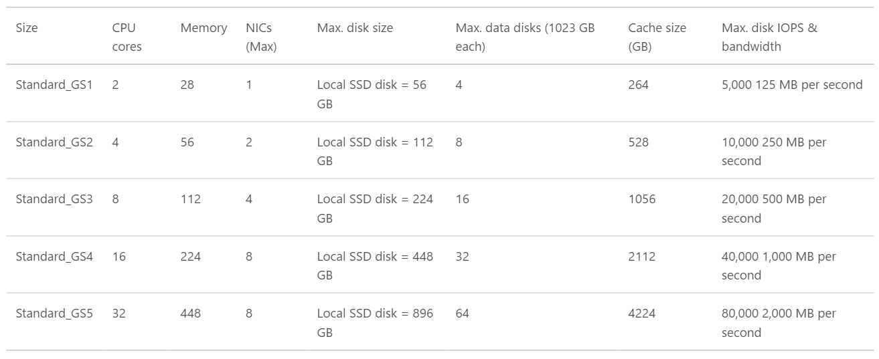
GS-series VMs , Godzilla ++ (Premium Storage- high-performance, low-latency storage for I/O intensive workloads.)

Slide 21
Microsoft Linux

Slide 22
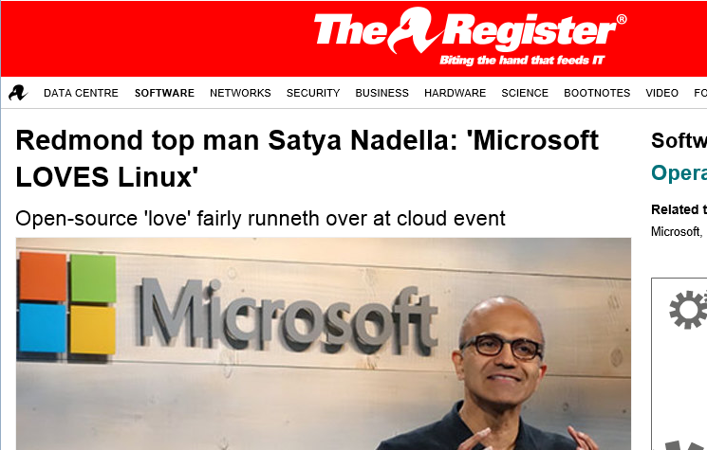
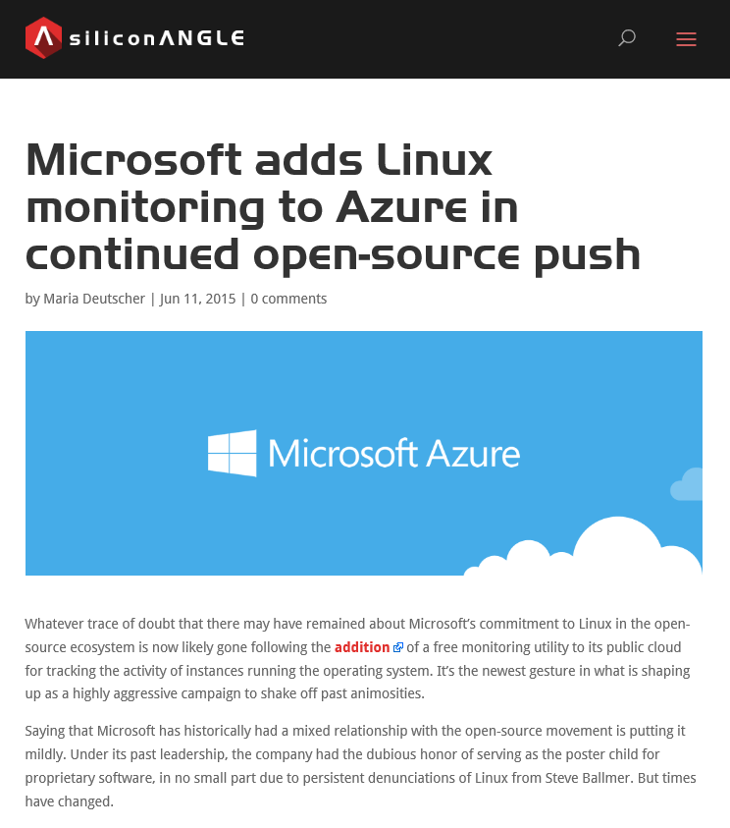
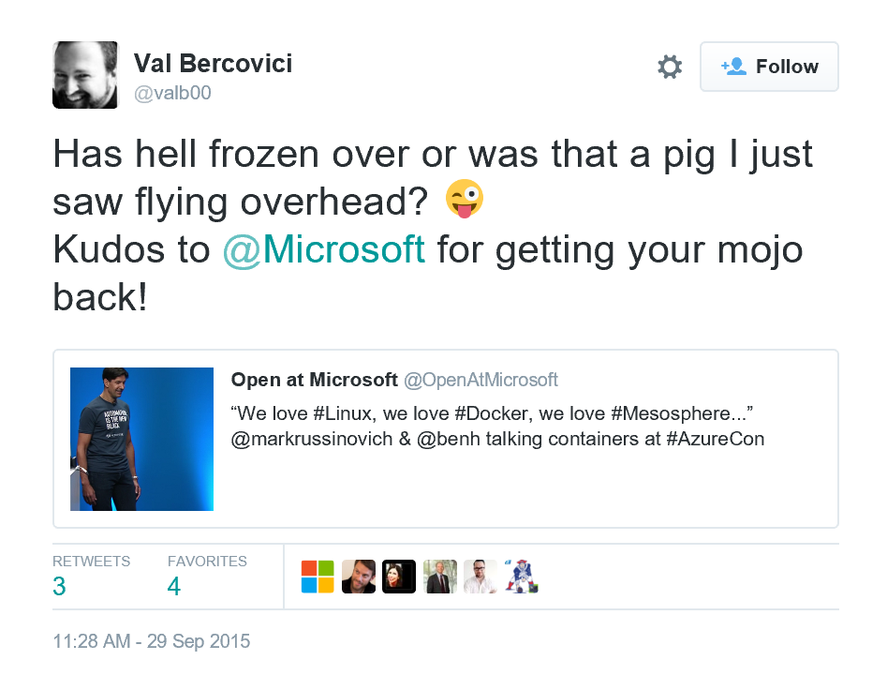
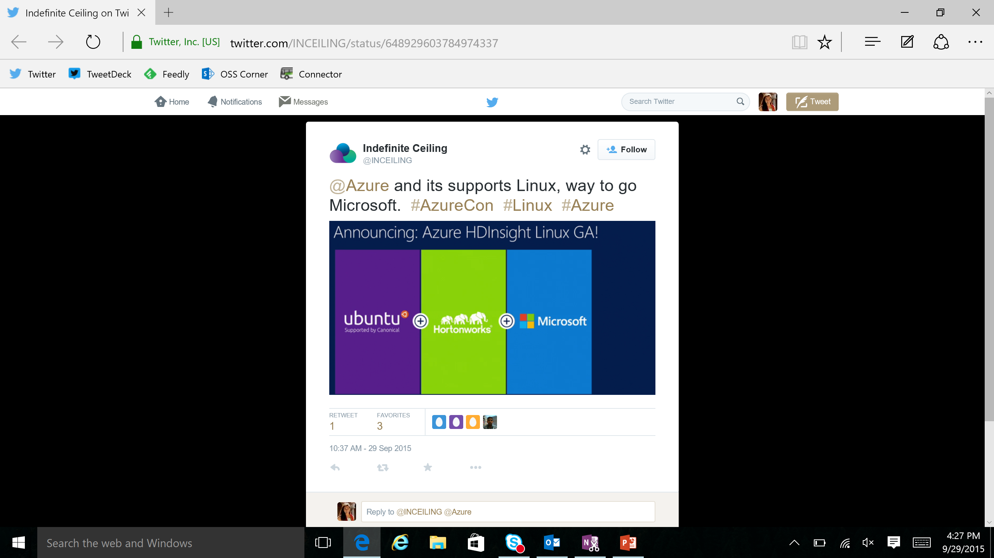
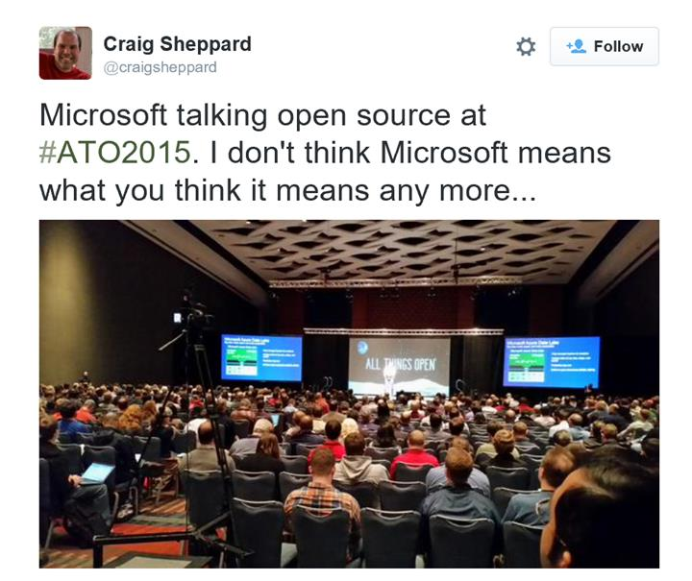
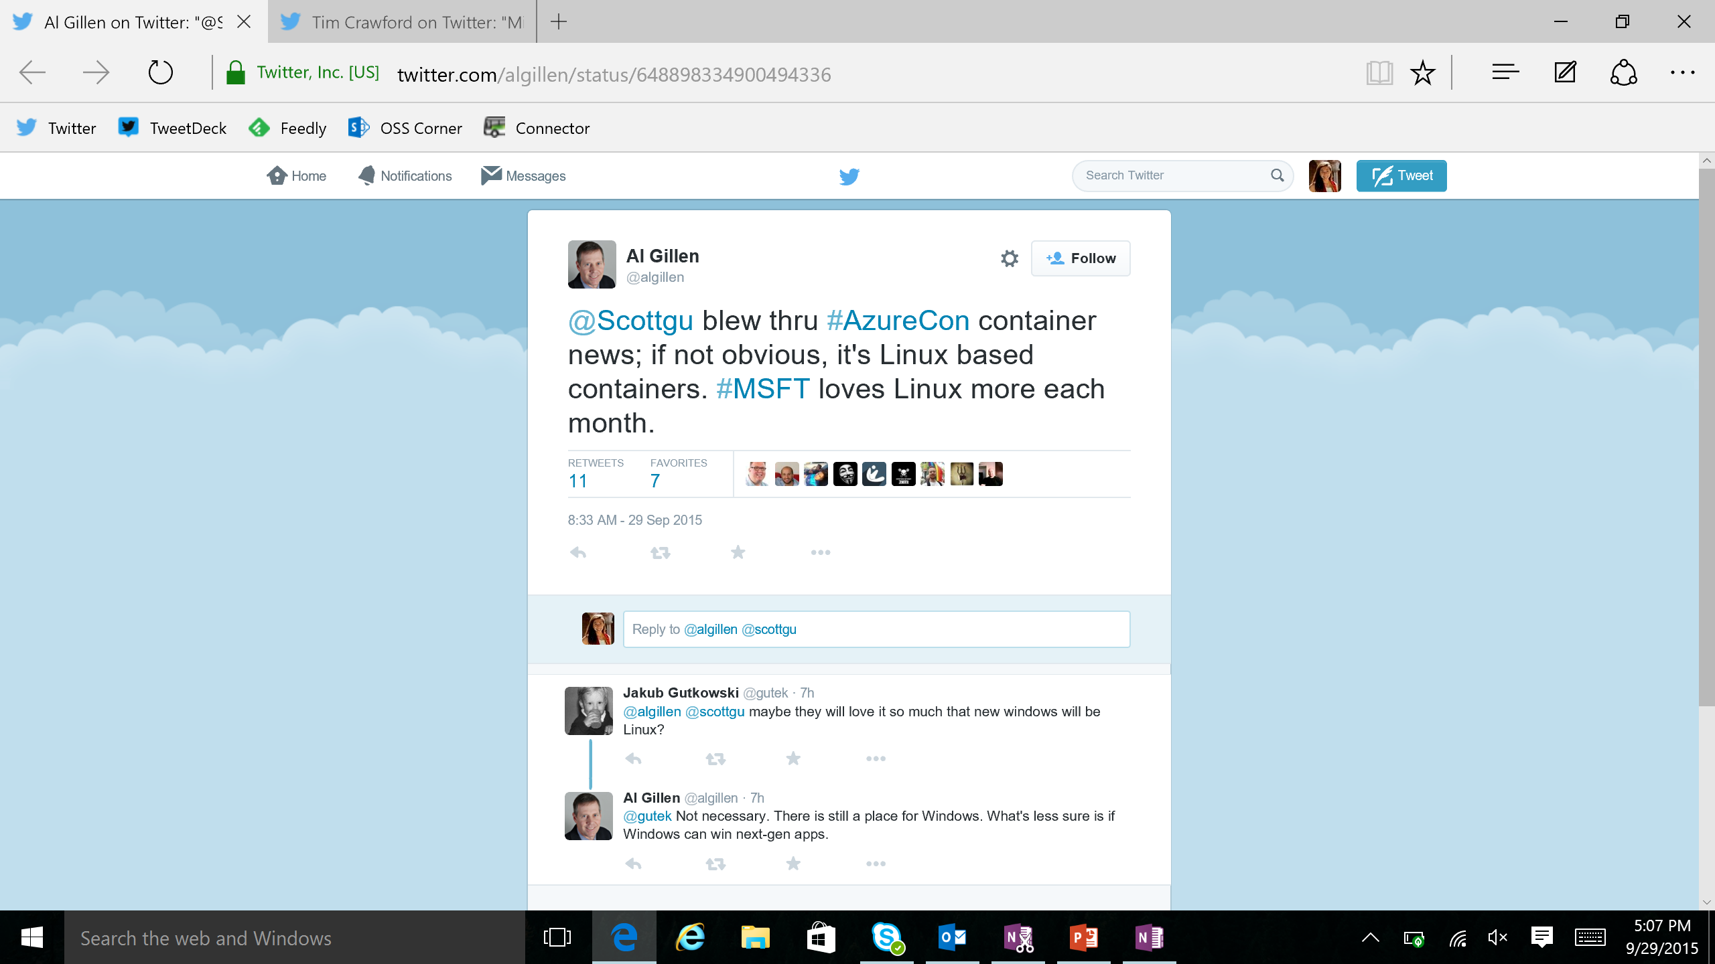

Slide 23
Microsoft is committed to Linux and open source
Linux is a real business for Microsoft
25% of IaaS VMs in Azure are Linux
System Center manages hundreds of thousands of Linux/UNIX servers
Many enterprises and service providers
run Linux as a guest on Hyper-V
… and we’re been in a long open source journey!
System Center has managed Linux and
UNIX servers since 2009
Linux drivers for Hyper-V available since 2010
Azure IaaS has run
Linux VMs since
“day 1” in 2013
Linux and open source are a fundamental part of how we do business
Today

Slide 24



Get started
Visit azure.microsoft.com

